Slide 1
Lecture 16
Types of Virtualization

Slide 2
Virtualization
Creation of a virtual version of something
Simulates hardware functionality to create a virtual system

Slide 3
Virtual Machine
Virtualization/emulation of a computer system
Based on computer architectures
Provide functionality of a physical computer
implementations may involve specialized hardware, software, or a combination.

Slide 4
System Virtual Machine
Provide a substitute for a real machine

Slide 5
Process Virtual Machine
Designed to execute computer programs in a platform-independent environment.

Slide 6
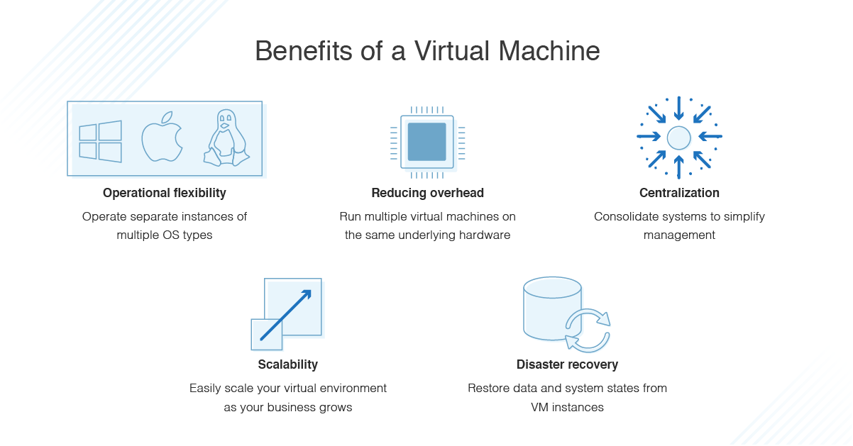

Slide 7
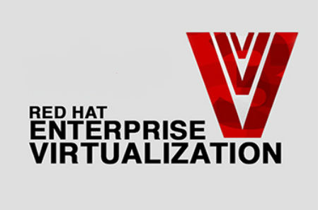




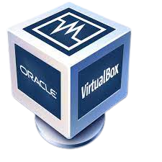
Hypervisor
Software that creates and runs a virtual machine

Slide 8
Type 1 Hypervisor
runs directly on the underlying computer's physical hardware, interacting directly with its CPU, memory, and physical storage

Slide 9
Type 2 Hypervisor
virtual machine (VM) manager that is installed as a software application on an existing operating system (OS)

Slide 10
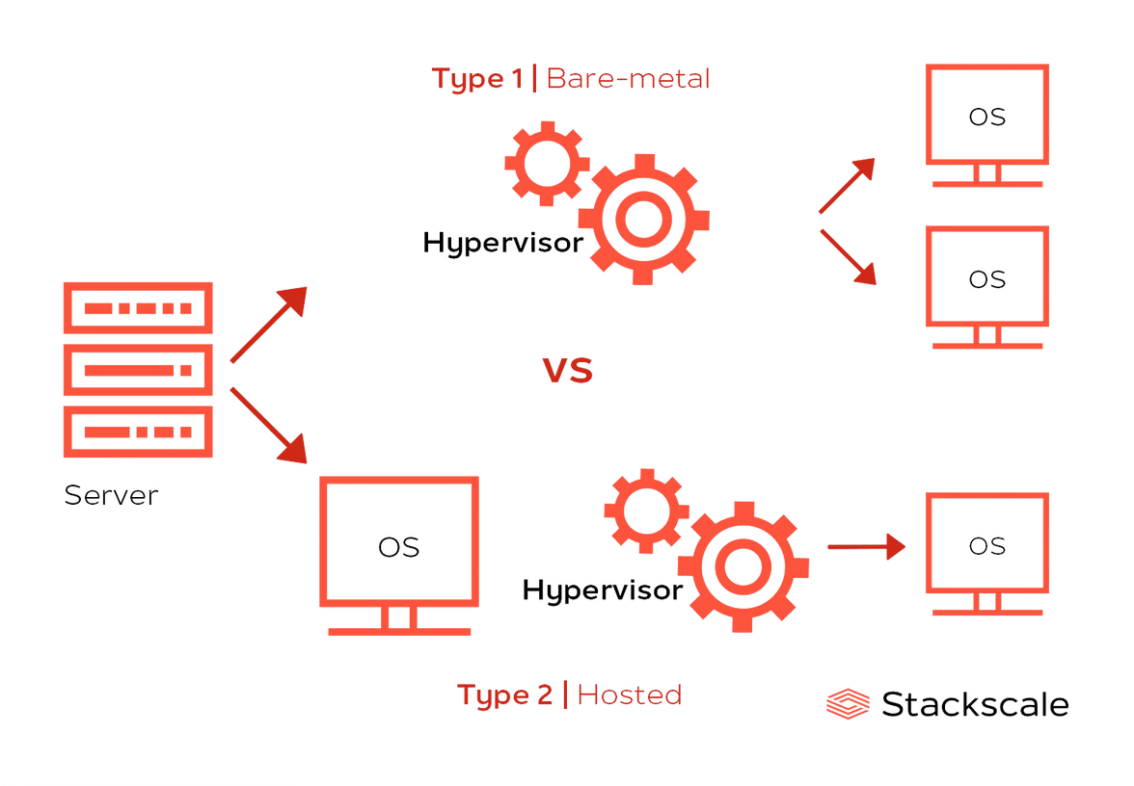
Type 1 vs Type 2 Hypervisors
Type 1 runs on bare metal and Type 2 runs on top of an operating system.

Slide 11
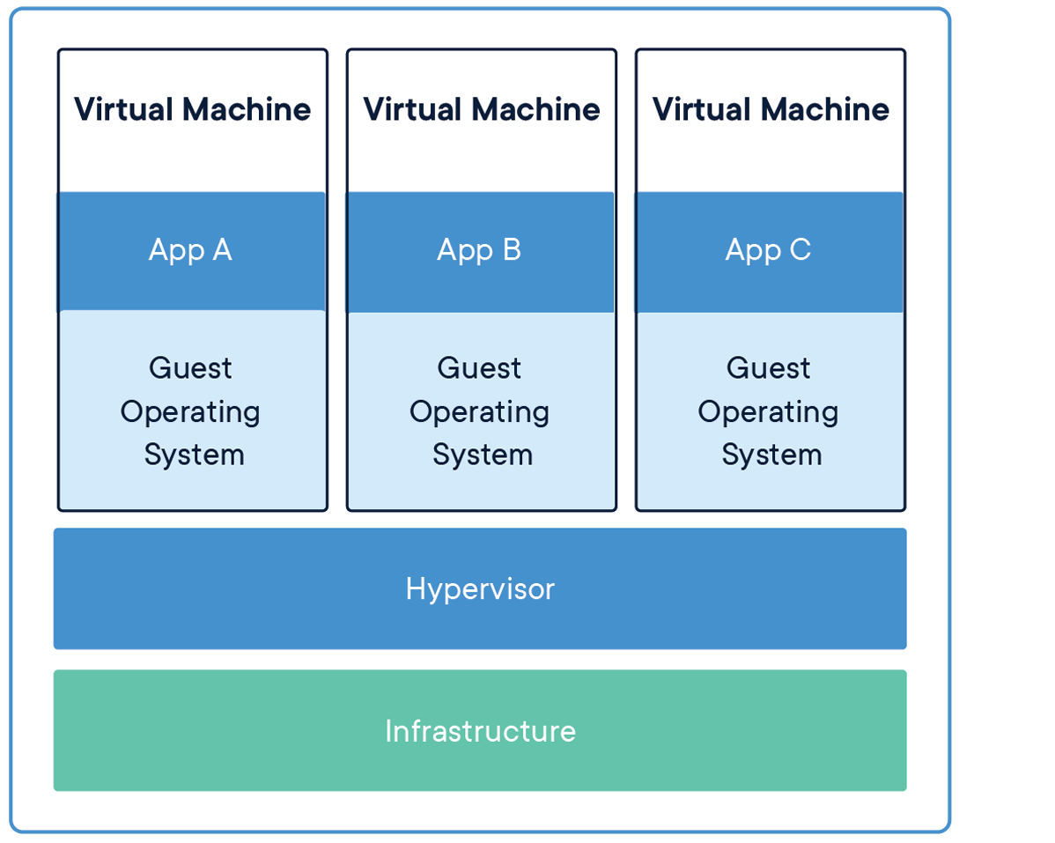

Slide 12

Ask Questions!!

